Slide 1
Secure and scale your AI APIs with Azure API Management + API Center
John Carroll
Senior Global Black Belt, AI Apps SE at Microsoft

Slide 2




The Evolution of Communication Protocols
AI Agents
SaaS
MCP
Installers
REST/JSON
Binaries
SOAP/XML
RPC/Binary
Notes:
Let’s begin in the early days – our floppy disk ear of protocols - With an RPC “binary” protocol used to transmit RPC requests and responses in a binary format. Then we are entering our USB driver era, where we had SOAP using XML for message formatting to facilitate the exchange of structured information between applications.
Now, it is taking off, our Smartphone era. With REST APIs and JSON format used for data exchanges on the web.
And now finally, the era we are currently in, the ear of intelligent agents. And now, what is the protocol we are looking at now.
MCP – model context protocol – a new standard designed to integrate external tools and data sources with AI agents. This is of course not where we are going to stop. A2A is already here and we are exploring capabilities there as well.

Slide 3






















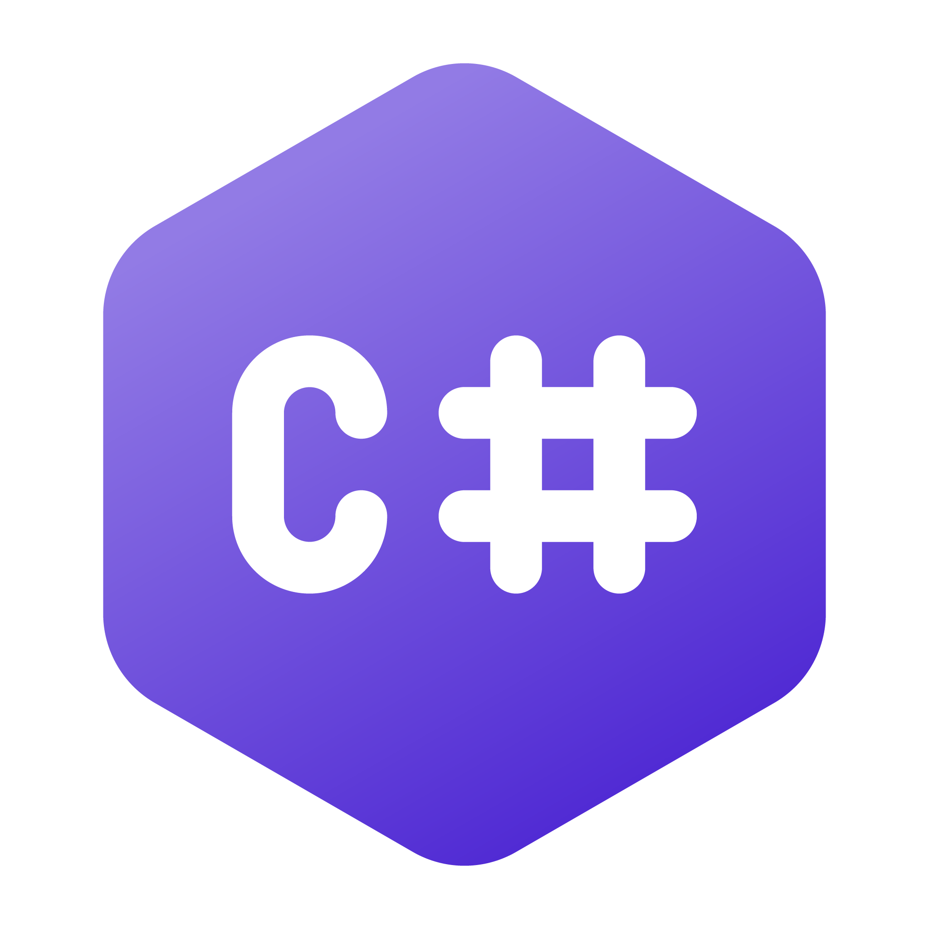




Model Context Protocol at Microsoft
Copilot Studio
VS Code
Foundry Agent
Visual Studio
GitHub Copilot
Microsoft Teams
Semantic Kernel
MCP Clients & Host
Community
Enterprise
Windows
Tools
Registry
C# MCP SDK
Azure API Management
Azure Functions
Microsoft Connectors
Build Local & Remote MCPs
MPC enables seamless Integration between LLM Apps and external data sources
Model Context Protocol

Slide 4
Core Architecture - MCP
MCP is an open protocol that standardizes how applications provide context to LLMs
The flexibility to switch between LLM providers and vendors
MCP follows a client-server architecture where a host application can connect to multiple servers
All transports use JSON-RPC 2.0 to exchange messages (stdio / HTTP with SSE)
MCP Server A
Local Data Source A
Host with MCP Clients
(GitHub Copilot, Claude, Copilot Studio)
MCP Protocol
MCP Protocol
Web APIs
Remote Service B
MCP Server B

Slide 5
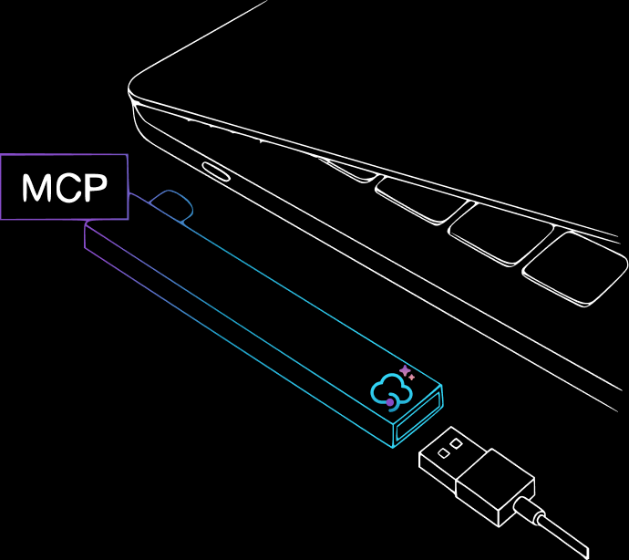

MCP Servers and Current Challenges
Duplicating Development Efforts
Building new MCP servers from scratch can lead to redundant work, especially when existing APIs already provide much of the needed functionality.
AI Models
Security Concerns
Server Trust: Malicious MCP servers can impersonate legitimate servers, leading to potential security breaches.
Credential Management: Storing sensitive data like tokens makes them susceptible to theft.
Registry and Discovery
Developing a centralized, organizational MCP registry for streamlined server discovery and metadata management is crucial for MCP's full potential.
External Data & Tools

Slide 6



MCP & API Management
Model Context Protocol
API Management (APIM/C)
The Model Context Protocol (MCP) is quickly becoming the standard for integrating Tools (external data sources) with Agents.
MCP utilizes a client-host-server architecture built upon JSON-RPC 2.0 for messaging (a type of API).
Communication between clients and servers occurs over defined transport layers, primarily:
stdio: Standard input/output, suitable for efficient communication when the client and server run on the same machine.
HTTP with Server-Sent Events (SSE): Uses HTTP POST for client-to-server messages and SSE for server-to-client messages, enabling communication over networks, including remote servers.
By treating MCP server endpoints as other backend APIs, organizations can apply familiar governance, security, and operational controls.
With MCP adoption, the need for robust management of these backend services will intensify.
API Management retains a vital role in governing these underlying assets:
Applying security controls to protect the backend resources
Ensuring reliability
Effective monitoring and troubleshooting with tracing requests and context flow

Slide 7







Expose Existing APIs as MCP Servers
Preview
Expose any APIM-managed REST API as a remote MCP server (SSE & Streamable HTTP)
Azure API Management
OpenAPI
Deploy
APIs
Expose
Quickly transform existing data into tools usable by LLMs
MCPs
Policies
Tools
Maintain governance, flexibility, and scalability with API Management policies
MCP Clients
Blog 📃
aka.ms/apimdocs/exportmcp
Notes:
https://learn.microsoft.com/en-us/azure/api-management/export-rest-mcp-server An MCP server exposes selected API operations to AI clients over JSON-RPC via HTTP or Server-Sent Events (SSE). These operations, referred to as “tools,” can be invoked by AI agents through natural language prompts.
With this new capability, you can expose your existing REST APIs in Azure API Management as MCP servers—without rebuilding or rehosting them.
Addressing common challenges
Before this capability, customers faced several challenges when implementing MCP support:
Duplicating development efforts: Building MCP servers from scratch often led to unnecessary work when existing REST APIs already provided much of the needed functionality.
Security concerns:
Server trust: Malicious servers could impersonate trusted ones.
Credential management: Self-hosted MCP implementations often had to manage sensitive credentials like OAuth tokens.
Registry and discovery: Without a centralized registry, discovering and managing MCP tools was manual and fragmented, making it hard to scale securely across teams.
API Management now addresses these concerns by serving as a managed, policy-enforced hosting surface for MCP tools—offering centralized control, observability, and security.

Slide 8







Protect your remote MCP Servers
Generally Available
Azure API Management
Microsoft Entra ID
Build remote MCP servers with Azure Functions/ Azure Container Apps
MCP Clients
MCP servers
Safety Policies
Protect and secure your remote MCP server endpoints with Azure API Management
Logs & Metrics
Azure Monitor
Sample
aka.ms/mcp-remote-apim-auth
Notes:
Benefits of using Azure API Management with MCP
By exposing MCP servers through Azure API Management, customers gain:
Centralized governance for API access, authentication, and usage policies
Secure connectivity using OAuth 2.0 and subscription keys
Granular control over which API operations are exposed to AI agents as tools
Built-in observability through APIM’s monitoring and diagnostics features
How it works
MCP servers: In your API Management instance navigate to MCP servers
Choose an API: + Create a new MCP Server and select the REST API you wish to expose.
Configure the MCP Server: Select the API operations you want to expose as tools. These can be all or a subset of your API’s methods.
Test and Integrate: Use tools like MCP Inspector or Visual Studio Code (in agent mode) to connect, test, and invoke the tools from your AI host.

Slide 9



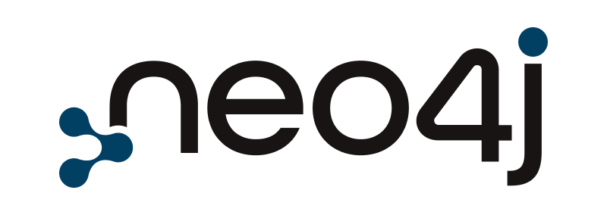



Private MCP Registry for Organizations
Preview
Azure API Management
Azure API Center
APIC Free no time restriction
APIC Standard included with APIM Standard & Premium SKUs for no additional charge
1st Party MCPs
MCPs
Deploy
MCPs
MCPs
Security
…
Security
Security
Logs & Metrics
MCP Registry
Enable MCP Discovery and Consumption across the Enterprise
3rd Party MCPs
MCP
MCP
MCP
MCPs
MCP
Host
….
Security
Expose
Logs & Metrics
Expose your MCP servers to GitHub Copilot in VS code and Copilot Studio
MCP Clients

Slide 10
APIM 💟 MCP
Expose your REST APIs as MCP servers:
Documentation: aka.ms/apimdocs/exportmcp
Blog: https://aka.ms/build25-apim-mcp
Feedback / Log an issue: https://aka.ms/apim-mcp-feedback
MCP Client Auth with APIM as your AI gateway:
Blog Post: https://aka.ms/remote-mcp-apim-auth-blog
Sequence Diagram: https://aka.ms/mcp-remote-apim-auth-diagram
APIM lab: https://aka.ms/ai-gateway-lab-mcp-client-auth
Python: https://aka.ms/mcp-remote-apim-auth
.NET: https://aka.ms/mcp-remote-apim-auth-dotnet
3rd Party APIs – Backend Auth via Credential Manager:
Blog Post: https://aka.ms/remote-mcp-apim-lab-blog
APIM lab: https://aka.ms/ai-gateway-lab-mcp
YouTube Video: https://aka.ms/ai-gateway-lab-demo
API Center – Enterprise MCP registry:
Blog Post: https://aka.ms/build25-apim-mcp
APIC lab: https://aka.ms/ai-gateway-lab-mcp

Slide 11
🧠 Summary: Governance Comparison
FeatureFeature | APIM | APIC
Runtime security & access control | ✅ | ❌
Credential management (OAuth, tokens) | ✅ | ❌
Policy enforcement (throttling, transformation, quota) | ✅ | ❌
Discovery governance (who can find/use APIs) | ❌ | ✅
Metadata, ownership, versioning | ❌ | ✅
Central registry for MCP servers | ❌ | ✅
Notes:
✅ Governance in Azure API Management (APIM)
APIM provides runtime governance and security enforcement through:
🔐 Credential Manager
Manages OAuth 2.0 credentials for backend APIs.
Supports:
Token acquisition and refresh
User-delegated access
Service principal access
Credential caching
Enables secure proxying to SaaS backends, GraphQL federations, Azure Functions, etc.
📜 Access Policies
Define who can access which APIs and under what conditions.
Support for managed identities, user groups, and service principals.
🛡️ Security Features
Subscription keys
OAuth 2.0
Microsoft Entra ID integration
Defender for APIs
OWASP threat mitigation
🧩 Policy Engine
Apply transformation, validation, throttling, and routing policies.
Enforce governance at the API call level.
🆚 Governance in Azure API Center (APIC)
APIC focuses on discovery-time governance and catalog-level control:
📚 Metadata & Ownership
Track API ownership, versioning, and lifecycle.
Define who can register, discover, and consume APIs.
🔍 Semantic Search & Filtering
Govern how APIs are found and used by developers and agents.
🔐 Access Control
Control visibility and consumption of APIs across environments.

